Slide 1
Hacking
Name : Rupak Sarkar Roll No.: 14271024036 Stream : MCA Semester : Semester 2nd Subject : Introduction to Cyber Security Subject Code : MCAN-E205D

Slide 2

Introduction to Hacking
An effort to attack a computer system or a private network inside a computer is known as hacking. Simply, it is unauthorized access to or control of computer network security systems with the intention of committing a crime. Hacking is the process of finding some security holes in a computer system or network in order to gain access to personal or corporate information.
One example of computer hacking is the use of a password cracking technique to gain access to a computer system. The process of gaining illegal access to a computer system, or a group of computer systems, is known as hacking. This is accomplished by cracking the passwords and codes that grant access to systems. Cracking is the term used to describe the process of obtaining a password or code. The hacker is the individual who performs the hacking.

Slide 3
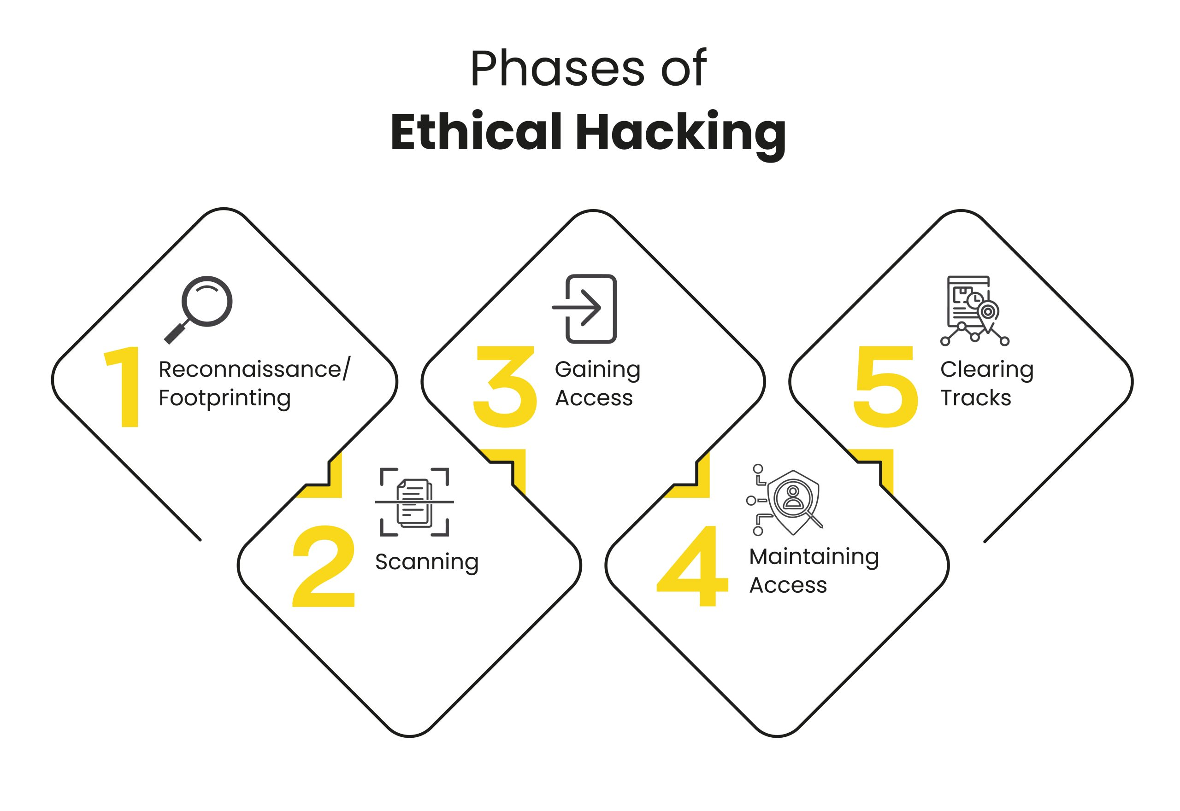
Steps of Hacking
Reconnaissance: This is the first phase where the Hacker tries to collect information about the target.
Scanning: This phase includes the usage of tools like dialers, port scanners, network mappers, sweepers, and vulnerability scanners to scan data.
Gaining Access: In this phase, the hacker designs the blueprint of the network of the target with the help of data collected during Phase 1 and Phase 2.
Maintaining Access: Once a hacker has gained access, they want to keep that access for future exploitation and attacks.
Clearing Tracks: Prior to the attack, the attacker would change their MAC address and run the attacking machine through at least one VPN to help cover their identity.

Slide 4
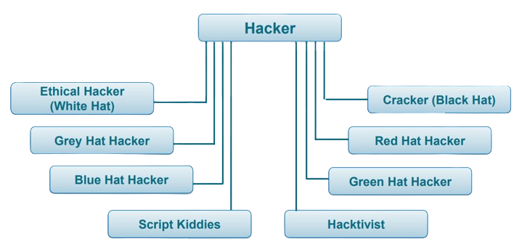
Different types of Hackers

Slide 5
Different types of Hackers
Ethical Hacker (White Hat)
These hackers work legally to improve security.
They find and fix vulnerabilities in systems to protect against cyberattacks.
Cracker (Black Hat)
They steal data, spread viruses, or cause damage for personal gain or revenge.
Malicious hackers who break into systems illegally.

Slide 6
Different types of Hackers
Grey Hat Hacker
A mix of ethical and malicious hackers.
They hack without permission but usually report vulnerabilities instead of exploiting them.
Green Hat Hacker
They usually study ethical hacking or penetration testing.
Beginners in hacking who are eager to learn and improve their skills.

Slide 7
Different types of Hackers
Red Hat Hacker
Also known as vigilante hackers.
They target black-hat hackers, using aggressive methods to stop them, sometimes even destroying their systems.
Blue Hat Hacker
Some also seek revenge through hacking.
These hackers work outside security teams to test software and identify bugs before launch.

Slide 8
Different types of Hackers
Script Kiddies
Inexperienced hackers who use pre-made tools and scripts without understanding how they work.
They often hack for fun or to show off.
Hacktivist
They expose corruption, protest government actions, or spread awareness.
Hackers who attack systems for political or social causes.

Slide 9
Thank You!

